Slide 1

Algorithm Visualizer
HIMANSHU CHAURASIYA(37)
VIKAS CHAURASIYA(38)
MUKESH GUPTA (39)
ASHLY JOHN (40)
Date of Presentation : 03/05/2023
Under the guidance of: Ms. Alvina Alphonso
St. Francis Institute of Technology
Department of Information Technology

Slide 2

Content
Introduction
Review of Literature
Research Gaps Identified
Problem Definition
Proposed Solution
Scope of Project
System Description
Hardware & Software Requirements
Implementation
Conclusion
Reference

Slide 3
Introduction
Algorithm visualization illustrates how algorithms and Advance data structure work in a graphical way. It mainly aims to simplify and deepen the understanding of algorithm operation.
Using professional articles of algorithms, animations, and responsive design , each algorithm can be learnt easily, Helps students identify their strengths and areas for improvement, Revisit topics multiple times and practice.
Every software engineer should have a good understanding of algorithms to develop efficient software. Visualizers have a good history of providing effective understanding to the users.

Slide 4
Review of Literature
Title | Author Name | Methodology
A Tool for Data Structure Visualization and User-defined Algorithm Animation. | Chen, Tao & Sobh, Tarek | Algorithms Visualizations contribute to improving computer science education. The method of teaching and learning algorithms is commonly complex to understand the problem. Visualization is a helpful technique for learning in any engineering course. In this report, an e-learning tool for Pathfinder, Prime Numbers, Sorting Algorithms, N Queen, Convex Hull, Binary Search Game visualization is described[9]. For example, In sorting the animation tool would represent information as a bar and once choosing a data-ordering and algorithms, the user will run an automatic animation or step through it at their own pace.

Slide 5
Review of Literature
Title | Author Name | Methodology
Sliding Window Algorithms for k-Clustering Problems. | Borassi, Michele & Epasto, Alessandro & Lattanzi, Silvio & Vassilvitskii, Sergei & Zadimoghaddam, Morteza | This paper[1] we can understand that they have implemented a k-clustering problem by using Sliding Window technique for grouping data into k clusters so that elements within the same cluster are similar to each other that were related to the unsupervised machine learning algorithms. They have presented the first algorithms for the k-clustering problem on sliding windows with space linear in k. Empirically they have observed that the algorithm performs much better than the analytic bounds, and it allows to store only a small fraction of the input. A natural avenue for future work is to give a tighter analysis, and reduce this gap between theory and practice.

Slide 6
Review of Literature
Title | Author Name | Methodology
Coded Matrix Chain Multiplication | Fan, Xiaodi, Angel Saldivia, Pedro Soto, and Jun Li | In this research paper we can see the computation requirements for matrix chain multiplication. Matrix chain multiplication usually takes multiple rounds to be completed but in the paper a coding scheme was introduced that completes the chain multiplication in one single round. As computation of matrix takes multiple rounds it puts load on the server be it any server cloud or physical. Server working slow is a straggler. To mitigate the issue of straggler two methods can be used one is replication of task and coded based method[2]. They had successfully coded the method on Microsoft azure by which we could understand that the coding scheme significantly saves the time of the distributed matrix chain multiplication .

Slide 7
Review of Literature
Title | Author Name | Methodology
Longest Common Subsequence as Private Search. | Gondree, Mark & Mohassel, Payman | The paper provides information about how the researchers have considered the longest common subsequence LCS problem as a private search problem, where the task is to ﬁnd a string of (or embedding corresponding to) an LCS[4]. They have shown that deterministic selection strategies do not meet the privacy guarantees considered for private search problems and, in fact, may “leak” an amount of information proportional to the entire input.

Slide 8
Research Gaps Identified
[1]While these existing research results and developed websites paved the foundation to build an effective and intelligent AV system, there are still many limitations associated with these AV websites which cannot meet the pedagogy, usability and accessibility needs of students: the existing web pages do not have a consistent interface.
[1]Most AV systems provided promising results with their potential in demonstrating the algorithm and data structure step by step in animation in terms of changing values in the variables. However, the logic behind an algorithm cannot be revealed.
[2][3][4] We also found out that the algorithm which we are going to implemented is not visualized yet.
SFIT- IT department Project Title: Algorithm Visualizer

Slide 9
Problem Definition
To build a visualization tool which intend to facilitate the understanding of advance algorithm concepts by means of animation and visualization. .

Slide 10
Proposed Solution
1] The user can select the algorithm he/she wants to study.
2] User can manipulate data input.
3] Control the speed of the animation.
4] User can check-out the code corresponding to the animation.
SFIT- IT department Project Title: Algorithm Visualizer

Slide 11
Scope of Project
Currently we are implementing algorithms like Sliding Window, Longest Common Subsequence,matrix chain multiplication and Levenshtein Distance.
User information is not stored in our system.
A backend database connectivity is also important to the system to keep a record of the existing users and new ones along with providing them the feature of tracking their progress in their respective accounts.
Our proposed system can be used to enhance the traditional classroom education and textbook for Data Structures and Basic Geometric Algorithms courses
SFIT- IT department Project Title: Algorithm Visualizer

Slide 12
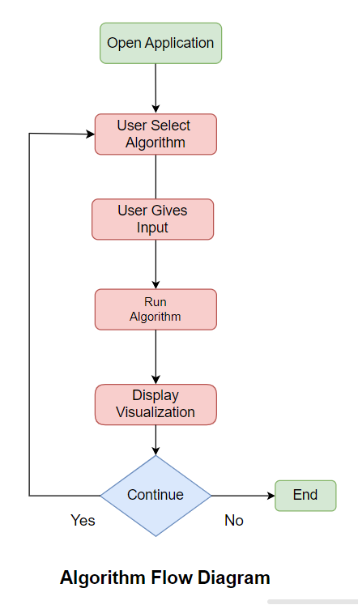
Block Diagram

Slide 13
Hardware & Software Requirements
Software requirements:
Operating System:Window 7 and above
Front end:HTML, CSS ,Bootstrap,reactjs
Editor: VS code
Hardware Requirements:
RAM :minimum 4 GB
Hard Drive:32 GB and above
Clock speed:2.5 GHz or above
CPU:intel i3/ryzen 3 or above

Slide 14
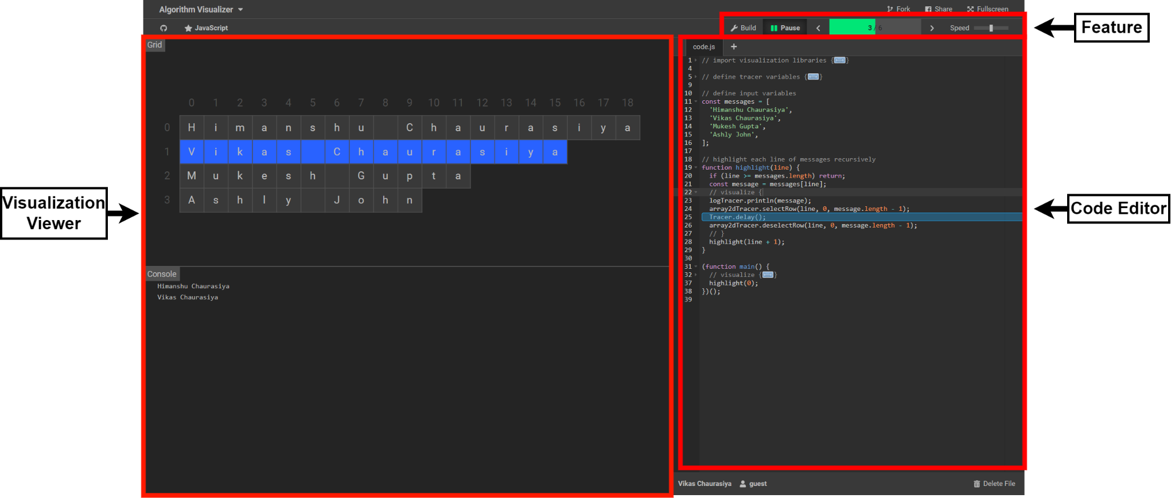
Implementation
Fig 1: User interface of Algorithm Visualizer

Slide 15
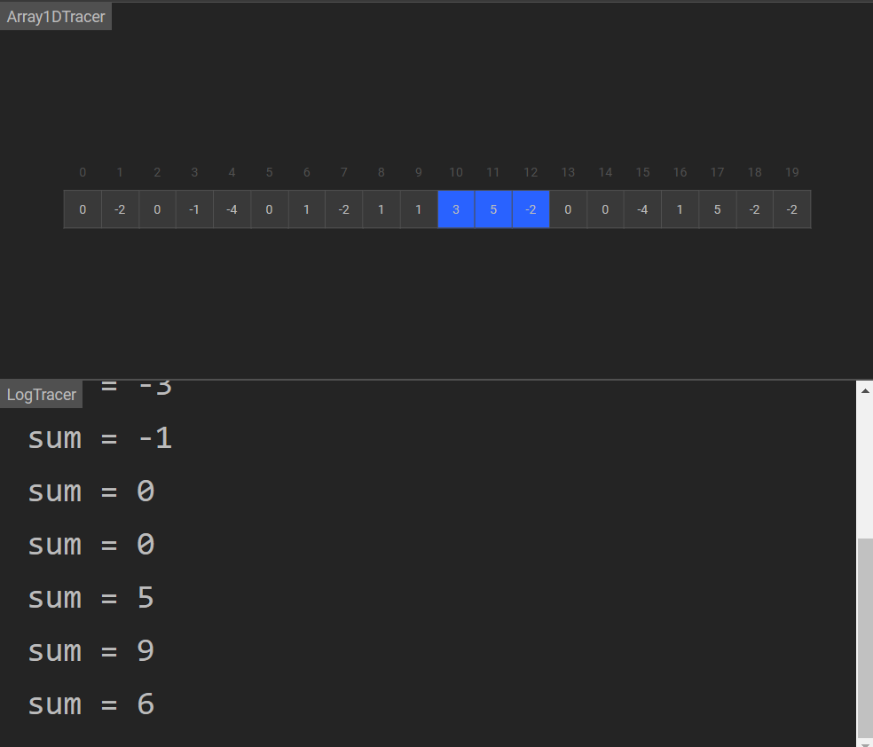
Fig 2: Visualization of Sliding Window

Slide 16
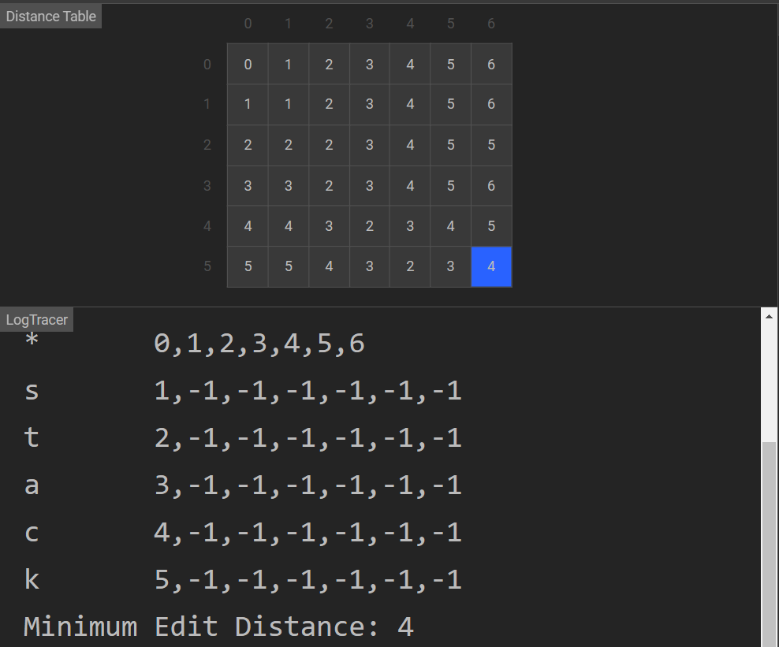
Fig 3: Visualization of Levenshtein Distance

Slide 17
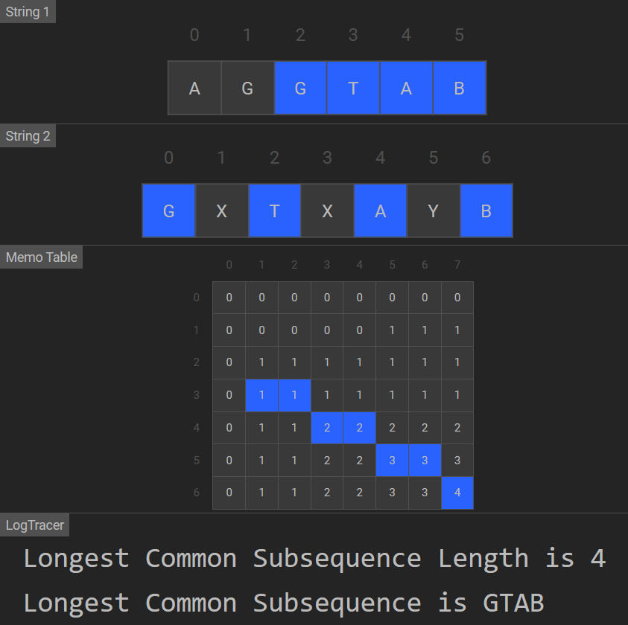
Fig 4: Visualization of Longest Common Subsequence

Slide 18
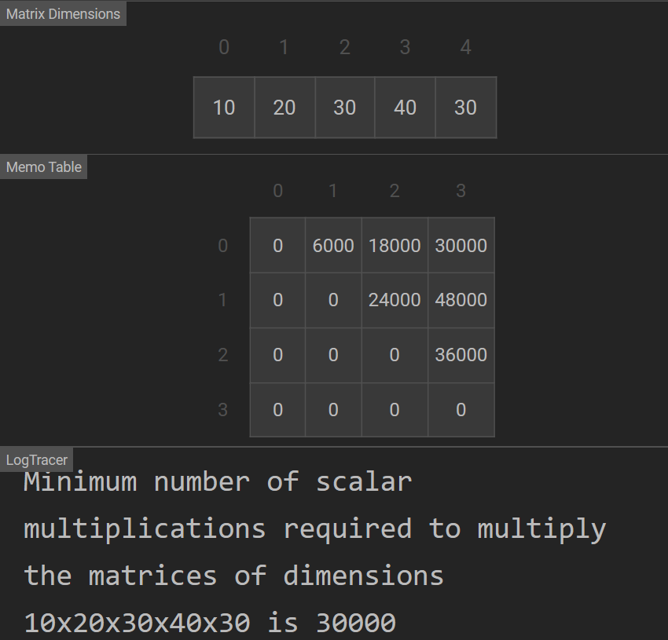
Fig 5: Visualization of Matrix Chain Multiplication

Slide 19
Conclusions
Algorithm visualization can be seen as a valuable supporting tool, used in addition to standard ways of education in the field of computer science. It has been found that it becomes easier for humans to retain the concepts when learnt through visualization than just textual or speech explanations.

Slide 20
References
1.Borassi, Michele & Epasto, Alessandro & Lattanzi, Silvio & Vassilvitskii, Sergei & Zadimoghaddam, Morteza. (2020). Sliding Window Algorithms for k-Clustering Problems.
2.Fan, Xiaodi, Angel Saldivia, Pedro Soto, and Jun Li. "Coded Matrix Chain Multiplication." In 2021 IEEE/ACM 29th International Symposium on Quality of Service (IWQOS), pp. 1-6. IEEE, 2021.
3.Haldar, Rishin & Mukhopadhyay, Debajyoti. (2011). Levenshtein Distance Technique in Dictionary Lookup Methods: An Improved Approach. Computing Research Repository - CORR.

Slide 21
References
4.Gondree, Mark & Mohassel, Payman. (2009). Longest Common Subsequence as Private Search. Proceedings of the ACM Conference on Computer and Communications Security. 81-90. 10.1145/1655188.1655200.
5. Brian Faria "Visualizing sorting algorithms" Rhode Island College 2017.
6. Pedro Moraes and Leopoldo Teixeira "Willow: A Tool for Interactive Programming Visualization to Help in the Data Structures and Algorithms Teaching-Learning Process" SBES 2019 2019.
SFIT- IT department Project Title: Algorithm Visualizer

Slide 22
References
7. Q. Gao and X. Xu "The analysis and research on computational complexity" The 26th Chinese Control and Decision Conference (2014 CCDC) pp. 3467-3472 2014.
8. Clifford A. Shaffer Matthew L. Cooper Alexander Joel D. Alon Monika Akbar Michael Stewart Sean Ponce et al. "Algorithm Visualization: The State of the Field" ACM Transactions on Computing Education vol. 10 no. 3 2010.
9. Tao Chen and T. Sobh, ”A tool for data structure visualization and user-defined algorithm animation,” 31st Annual Frontiers in Education Conference. Impact on Engineering and Science Education. Conference Proceedings, 2001, pp. TID-2.
SFIT- IT department Project Title: Algorithm Visualizer

Slide 23
Questions??
Thank You!

